Slide 1

Case study - Bike Share
A Data Warehouse Project using KNIME Analytics Platform and PostgreSQL
Paulo Argôlo
https://www.linkedin.com/in/pauloargolo
Jan 2024

Slide 2
Steps taken in this project Data Warehouse and ETL process
Designed a dimensional data model (see GiHub link);
Created a data warehouse in Postgres (staging and core layers);
Used KNIME Analytics Platform for data cleaning and manipulation and to load tables into Postgres (ETL/Data Pipeline);
Used MySQL to explore data and generate insights that would answer the business task, using joins, aggregate functions, temporary tables, CASE statements, subqueries, windows functions;
Used Tableau for data visualization, creating a dashboard with bar charts, pie charts, heat maps and calculated fields.

Slide 3
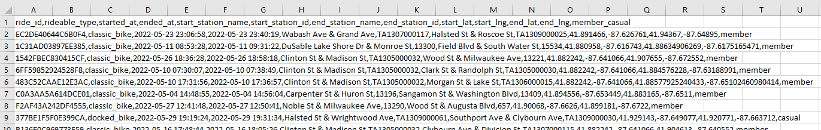
From CSV files into the Data Warehouse Dimensional data model
calendar lookup
date_pk
day_name
day_of_week
month_name
year
fact_rides
ride_pk
ride_id
started_at
ended_at
duration
started_at_fk
ended_at_fk
user_info_fk
location_fk
dim_location_info
location_pk
start_station_name
end_station_name
drop_off_distance
combation
start_coordinate
end_coordinate
dim_user_info
user_info_pk
rideable_type
member_casual
combination

Slide 4
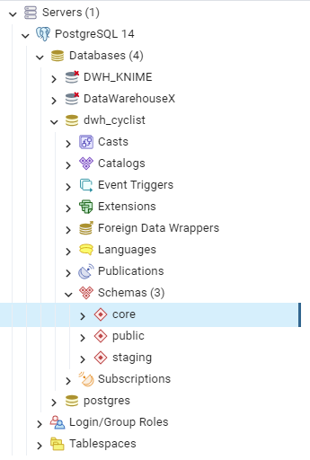
Data warehouse in Postgres Database and schemas
Created the dwh_cyclist database
Created three schemas
public → initial backup and storage of data retrieved from CSV files
stating → temporary layer where new data (delta load) is staged to be transformed and loaded in the core schema
core → layer were the fact and dimensional tables are stored

Slide 5
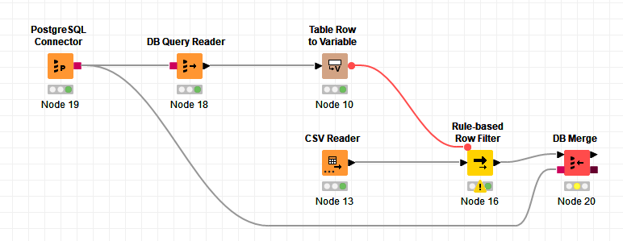
Extract from CSV to dwh_cyclist.public Data ingest using KNIME
1
2
3
4
In this initial step I connect to the Postgres server and query the data for the MAX value of the “started_at” column which stores a timestamp of the each ride.
Then I turn this value into a variable and read the folder where the CSV files are contained locally
Here I filter the data read from all CSV that came after the MAX(stated_at) value
Finally I use a DB Merge (inser/update) node to write into dwh_cyclist.public only the new values or update modified entries

Slide 6
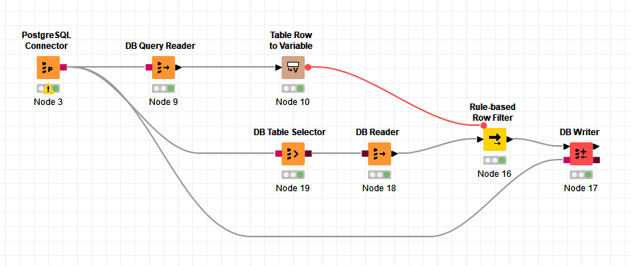
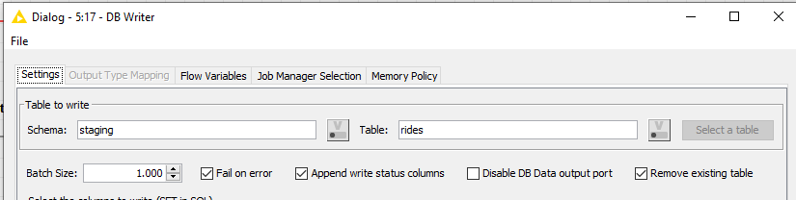
From public to dwh_cyclist.stating Staging layer
This workflow is very similar to the previously seen with only two differences:
I changed the CSV reader for a DB reader to read data from the public schema, and
I changed the DB Merge node for a DB Writer. This is because the goal is not insert/update the data in the staging layer, we only want write the new data and truncate if after it’s been loaded into the core layer. As seen in the dialog box, “remove existing table” is marked
2
1

Slide 7
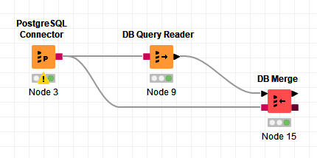
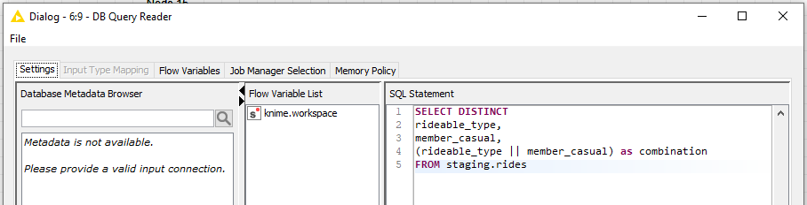
From staging in dimensional tables (1 of 2) dwh_cyclist.core.dim_user_info
Here the workflow looks quite simple but looking inside of the DB Query Reader we can see the SQL statement I wrote to create the dimensional table from the staging layer
This table has information about the type of ride that the user selected and also if the user is a member or a casual customer
Again using the DB Merge node as the goal is only to insert new values or update changes. If using DB Writer, the joins to the fact table could not work properly

Slide 8
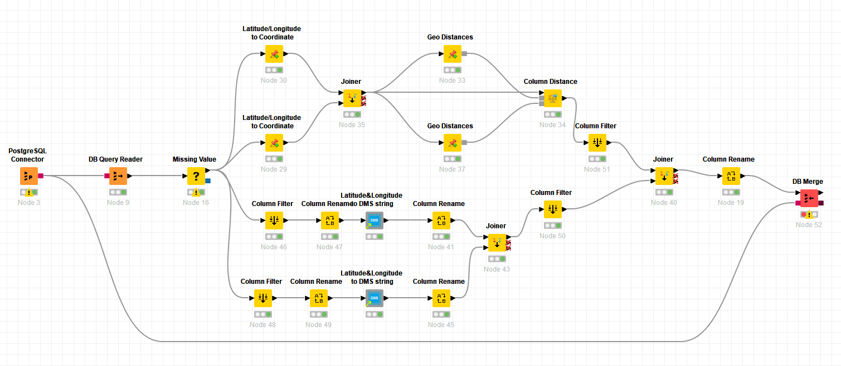
From staging in dimensional tables (2 of 2) dwh_cyclist.core.dim_location_info
Similar to the previous dimensional table but here several transformations are used to calculate the distance between the starting and ending place of the ride and also to create a column with the coordinates so that we can create heatmaps in BI tools in the analytics part.
For the transformation using joins, column filters, column renaming, filtering missing values, some custom node available in the KNIME community and at the end a DB Merge node

Slide 9
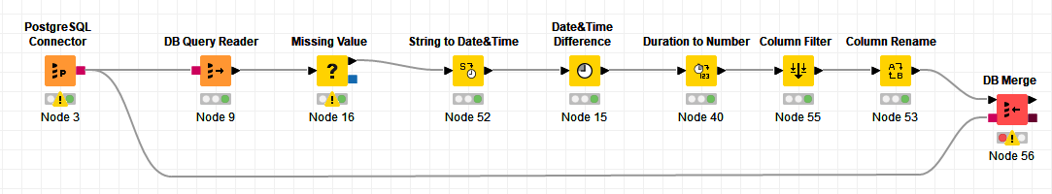
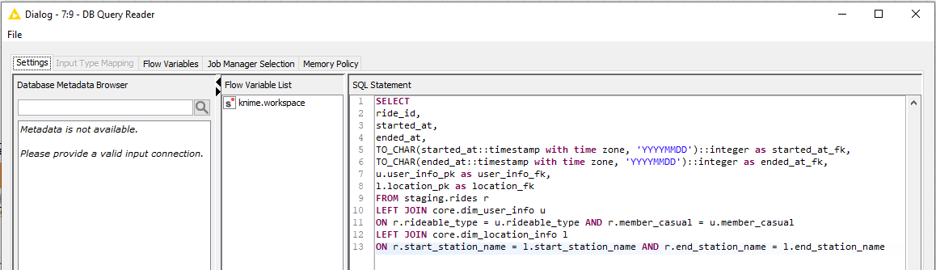
From staging to fact table dwh_cyclist.core.fact.rides
To create the fact table I wrote an SQL statement where we have the foreign keys to the dimensional tables
From there I cleaned missing values, filtered and renamed columns and created one metric called “duration” which calculates the time of each ride

Slide 10
Final thoughts
I did this project with a dataset that I was already familiar with when I did a previous SQL project. I’m really proud of what I was able to put together in terms of creating an ETL workflow in KNIME and creating a Data warehouse in Postgres.
I believe I’ve strengthened my knowledge in SQL and KNIME while applying the concepts and good practices I learn related to data warehouses.
My statement from the previous project is still very true:
I’m looking forward to what I will be able to accomplish with the next knowledge I acquire and the future tools I learn how to use.

